Slide 1
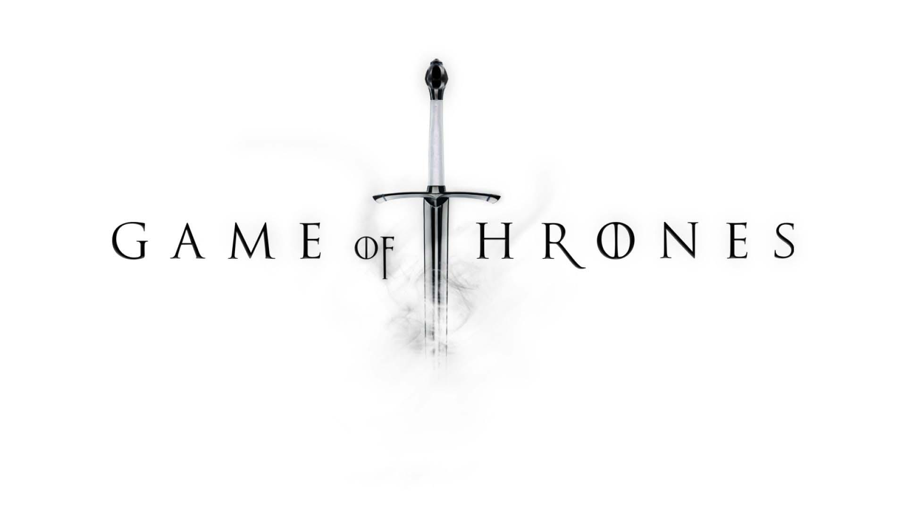
Sydney Akers Jun Xing
Allison Yan Cao Kailin Hu

Slide 2

Background & Purpose
Wanted to see how audience reacts to the popular TV show, Game of Thrones
We can get an idea of what improves ratings & viewership
Also get an idea of themes and trends in the show

Slide 3
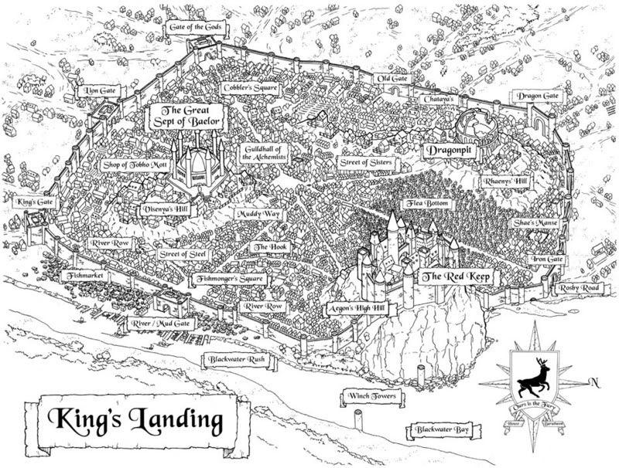
Finding 1: Major Storylines

Slide 4
Finding 1: Making of
Wanted to explore the impacts of major storylines on viewership and ratings
Spot the peaks and dips on the chart, and explore the reasoning behind them
Data retrieved from Wikipedia and IMDB
Aggregate number of viewers and maximum rating per episode
Episode numbers as x-axis and both viewership and rating as y-axes
Detrend the viewership line for better visualization

Slide 5
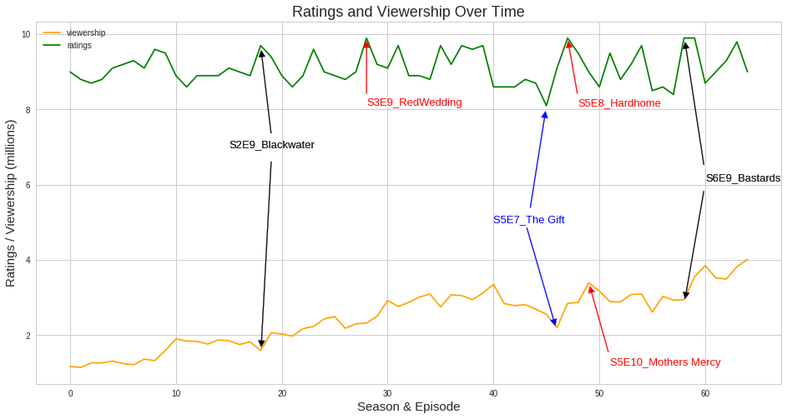
Data source: Wikipedia & IMDB

Slide 6

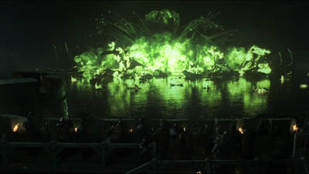
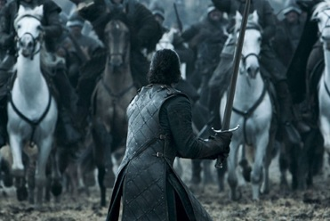
Controversials:
Blackwater:
Rating: One of the BEST in the series - "GoT delivers a thrilling tour de force in 'Blackwater,' an epic hour of blockbuster television full of spectacular battle sequences and equally powerful drama."
Viewership: Big drop due to Memorial Day Holiday.
Battle of the Bastards:
Rating: One of the BEST in the series - “'Battle of the Bastards' delivered one of the greatest battle sequences in the show's history, and some savagely satisfying vengeance as well."
Viewership: Drop due to competition with 2016 NBA Finals.
Source:
Blackwater: https://en.wikipedia.org/wiki/Blackwater_(Game_of_Thrones)
Battle of the Bastards: https://en.wikipedia.org/wiki/Battle_of_the_Bastards

Slide 7
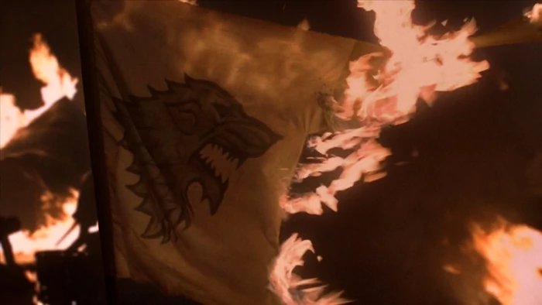
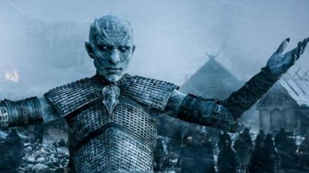
Peaks:
Red Wedding:
Rating: One of the BEST in the series - "The most unforgettable episode of Game of Thrones thus far, 'The Rains of Castamere' (or as it shall forever be known, 'The Red Wedding') packs a dramatic wallop that feels as exquisitely shocking as it does ultimately inevitable."
Viewership: Ranked as the highest-rated broadcast of the week.
Hardhome:
Rating: THE BEST - "Following several episodes of setup, 'Hardhome' blends a sharp script with spectacular blockbuster action to offer viewers a powerful, game-changing payoff."
Viewership: Ranked as the highest-rated broadcast of the week.
Source:
The Red Wedding: https://en.wikipedia.org/wiki/The_Rains_of_Castamere
Hardhome: https://en.wikipedia.org/wiki/Hardhome

Slide 8
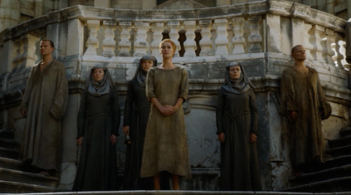
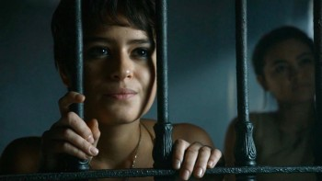
Mother’s Mercy:
Rating: Critical acclaim - "wraps up a particularly dark Game of Thrones season with a finale that delivers strong character work and a handful of appropriately bleak cliffhangers."
Viewership: Ranked as the highest-rated broadcast of the week.
Dips:
The Gift:
Rating: Critical acclaim - “'The Gift' is a jam-packed installment that delivers long-awaited plot turns in a satisfying manner, even though it continues a disturbing theme from the previous episode.”
Viewership: Biggest drop - backlash from the rape scene in "Unbowed, Unbent, Unbroken".
Source:
Mother’s Mercy: https://en.wikipedia.org/wiki/Mother%27s_Mercy The Gift: https://en.wikipedia.org/wiki/The_Gift_(Game_of_Thrones)

Slide 9

Finding 1 - Extra eventful episodes can be major driver to higher ratings & viewership
Viewership: Higher volume for eventful episodes, except conflicts with popular social events like federal holidays and sports events, etc. Also episodes having antisocial or moral issues tend to have big drop in viewership.
Ratings: Episodes with most dramatic storylines and battles tend to have higher ratings and critical reviews.

Slide 10

After seeing that controversial events and plot direction affected viewers’ and critics’ reception of the series, we decided to delve into fans’ opinions of both the major houses and individual characters.

Slide 11
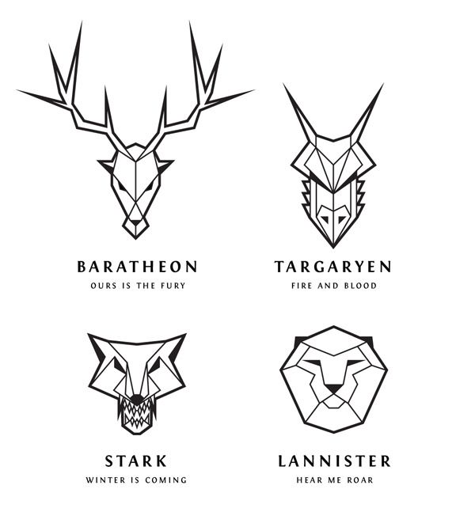
Finding 2: Moral Ambiguity

Slide 12

Finding 2: Making Of
Wanted to find out which house is the most “innocent” house in terms of betrayals and check how the moral aspect influence audience’s reception
Compare both betrayal counts and ratios for each house
Create a bar graph on Tableau and combine the perpetrators and victims on house level
Create a line for who betrayed more and who betrayed less
Include the result from favorite house survey
Betrayal Data from a fan blog on Venngage
Favorite House Survey data from Ranker

Slide 13

Finding 2: Making Of
Wanted to explore fans’ favorite villains and heroes and the betrayals in which they were involved
Expected high degree of moral ambiguity
Originally looked at both betrayals suffered and betrayals inflicted, but betrayals suffered didn’t offer much of a comparison
Betrayals data from Venngage
Viewer survey conducted by Rotten Tomatoes with over 1000 fans

Slide 14
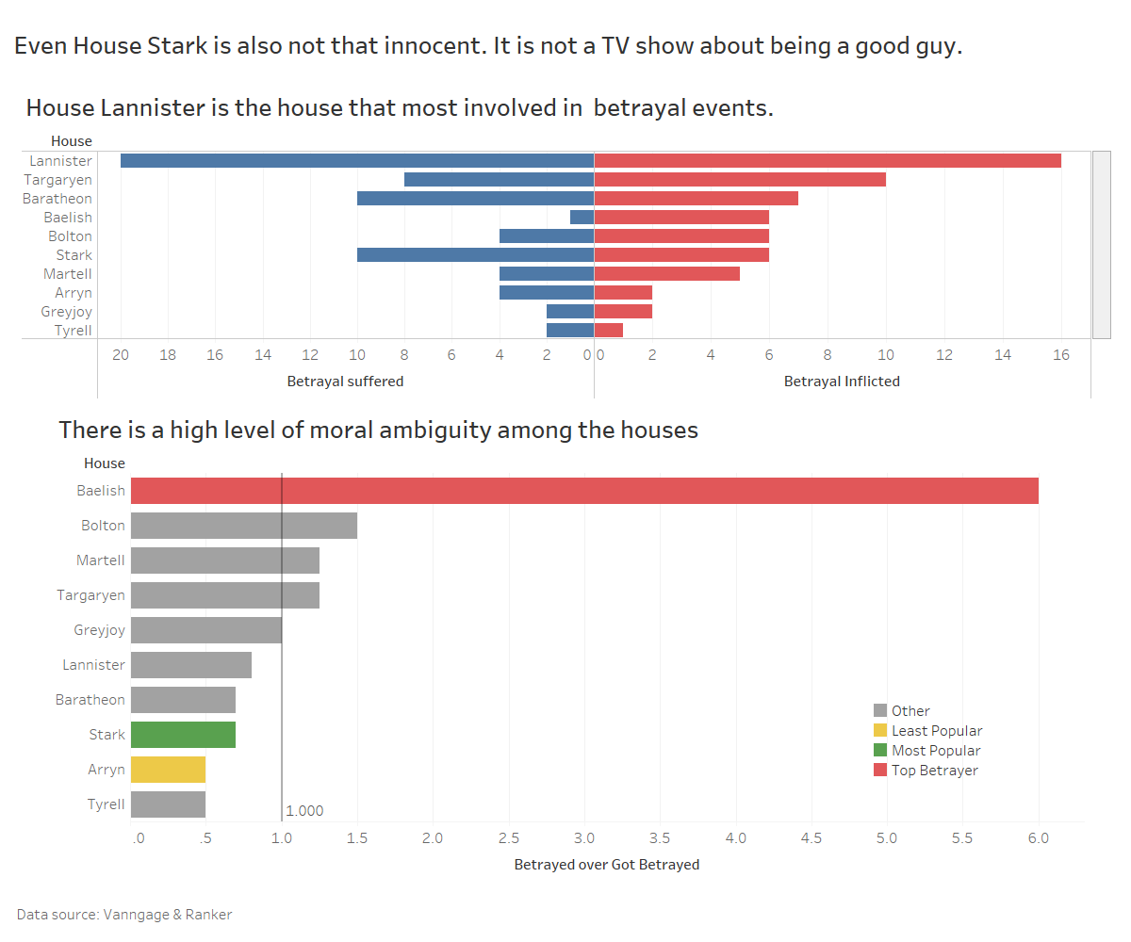
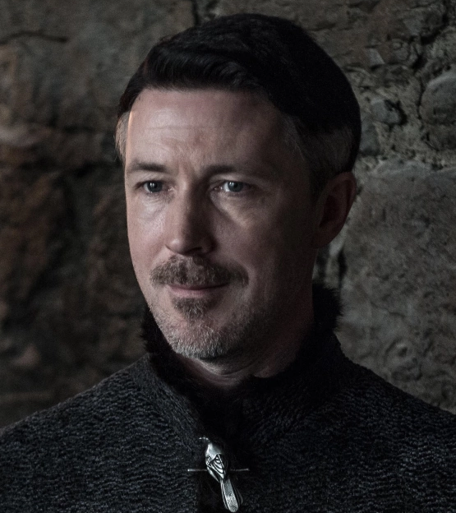
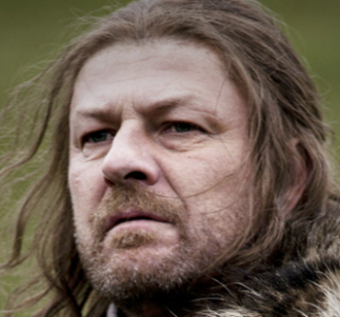
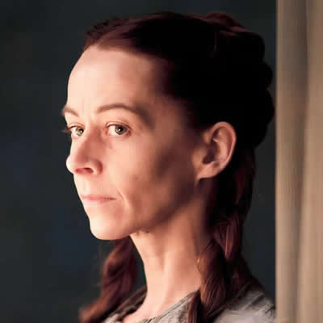
Finding 2:
There is a high degree of moral ambiguity among the houses. . .

Slide 15
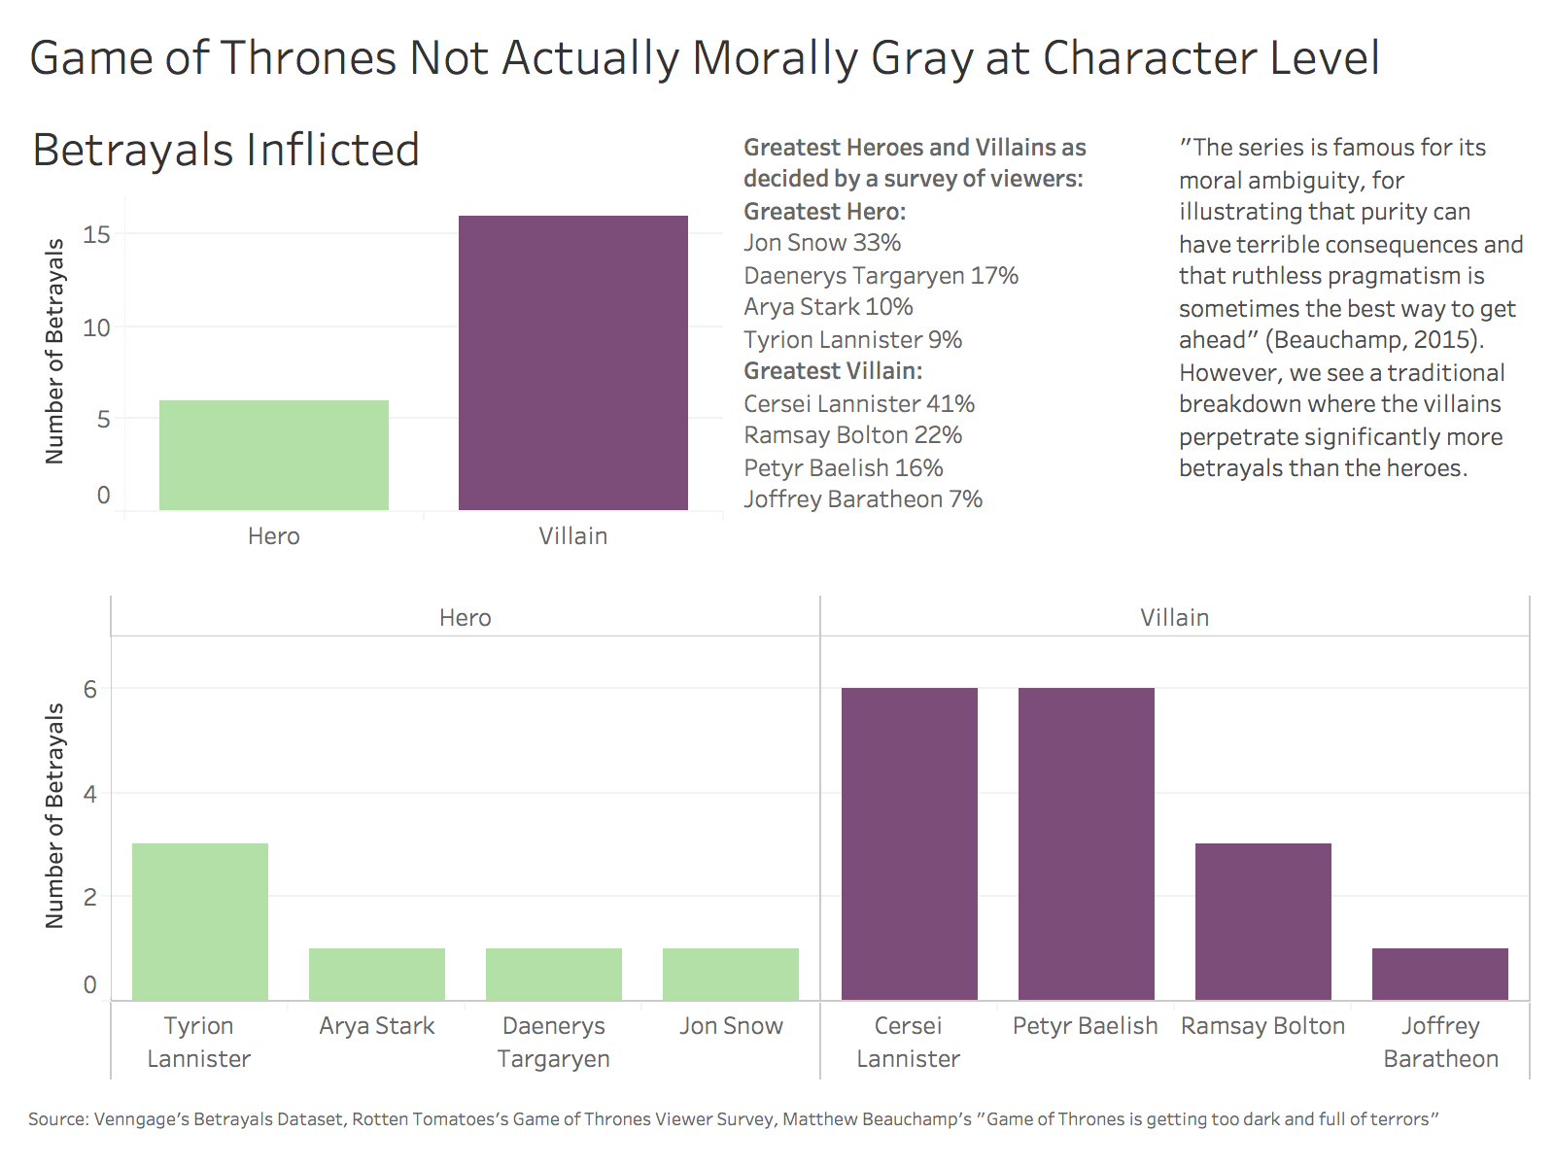
Finding 2:
. . .but clearer moral distinctions between heroes and villains

Slide 16


Finding 3: Differences in Gender Perception

Slide 17
Finding 3: Making Of
Survey data from Reddit (2017)
Data was already aggregated by character
Created new column: ‘favorite’ votes/’least favorite’ votes to get popularity ratio for each character
Sorted dataframe by ratio and plotted with seaborn
Added legend and color encoding

Slide 18
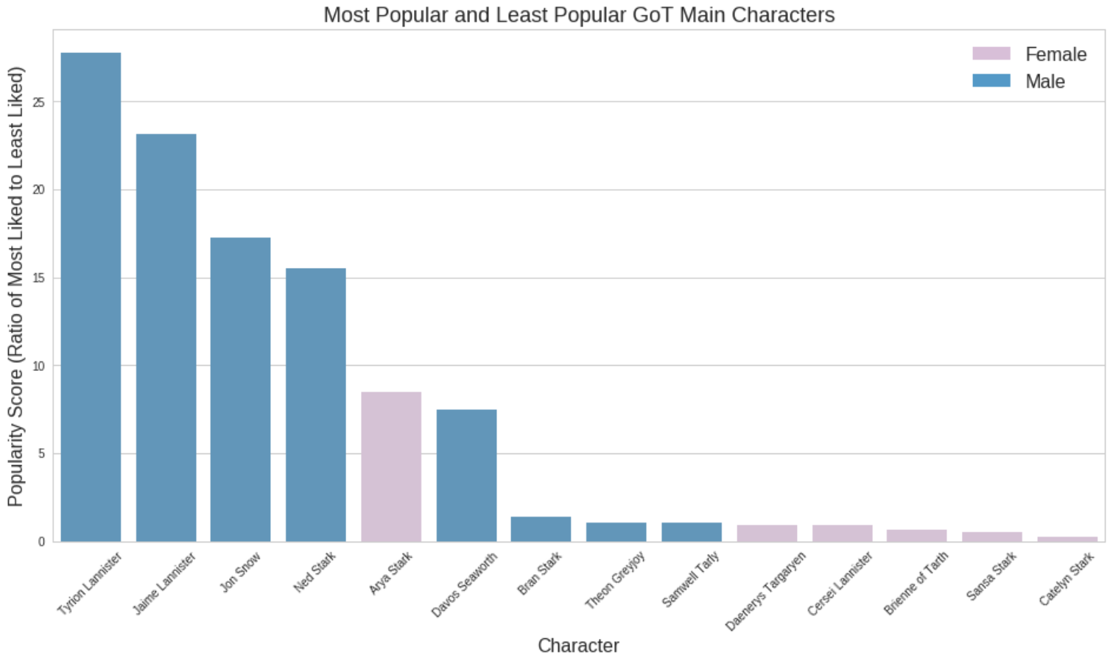
Finding 3
Data source: Reddit user survey (2017)

Slide 19
Finding 3 Cont’d
Besides Arya, all the female leads have very low popularity ratios
The betrayals finding shows that male leads actually commit more betrayals, yet they are much more liked than their female counterparts
Possible gender discrimination

Slide 20
Future features/ enhancements
The surprising gender bias finding led to the question of viewership gender breakdown, which we can incorporate into our finding 3
Feedback?

Slide 21
Thank You

